Slide 1


FLYWITH US
GROUP 1

Slide 2
FLYWITH US
AIRLINE BOOKING SYSTEM DATABASE DESIGN
PROJECT OVERVIEW:
Database System that stores and manages passenger flights operation
SCOPE:
Flight operators, flight details, bookings, and passenger information
GROUP MEMBERS
Lakshmi, Omar, Manraj
Raziah, Josh, Aldona,

Slide 3
Introduction Aldona
Company Overview
FlyWithUS is a dynamic airline travel company committed to providing exceptional service.
Our mission is to connect passengers with their destinations efficiently and safely.

Slide 4
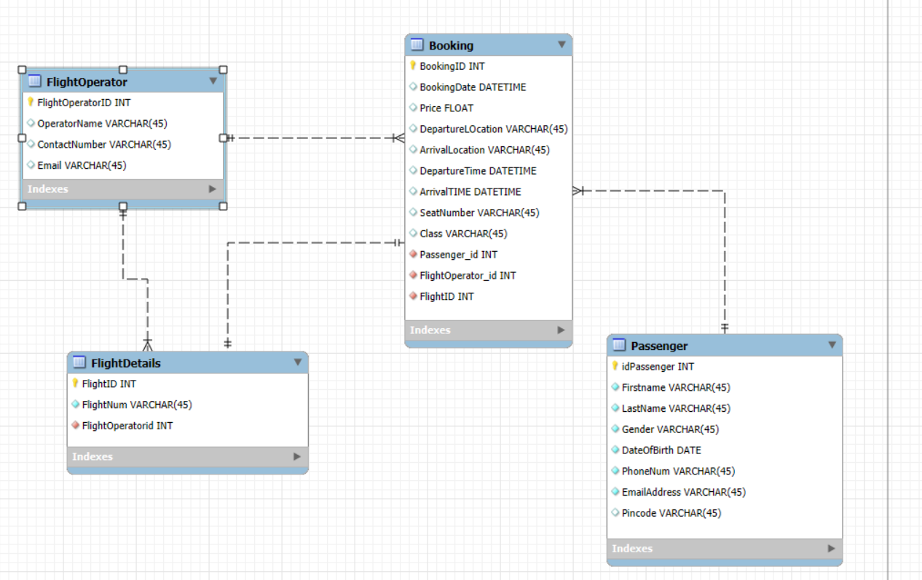
forwardsurge.org

Slide 5
SCHEMA MODEL
Database Tables
Passangers: This table captures essential customer information, including names, contact details, and preferences.
Bookings : Here, we track bookings made by customers. Each order includes departure and arrival details, as well as the total price.
Flight Operators : Our flight details reside in this table. It holds flight IDs, operator information, and other relevant data.
Flight details :Flights.

Slide 6
Data Integrity
Normalization
Achieving the 2nd Normal Form (2NF) ensures data consistency and minimizes redundancy.
By organizing our data efficiently, we enhance data integrity and maintain a robust database.
THANK YOU
GROUP MEMBERS
Lakshmi, Omar, Manraj
Raziah, Josh, Aldona,

